Slide 1
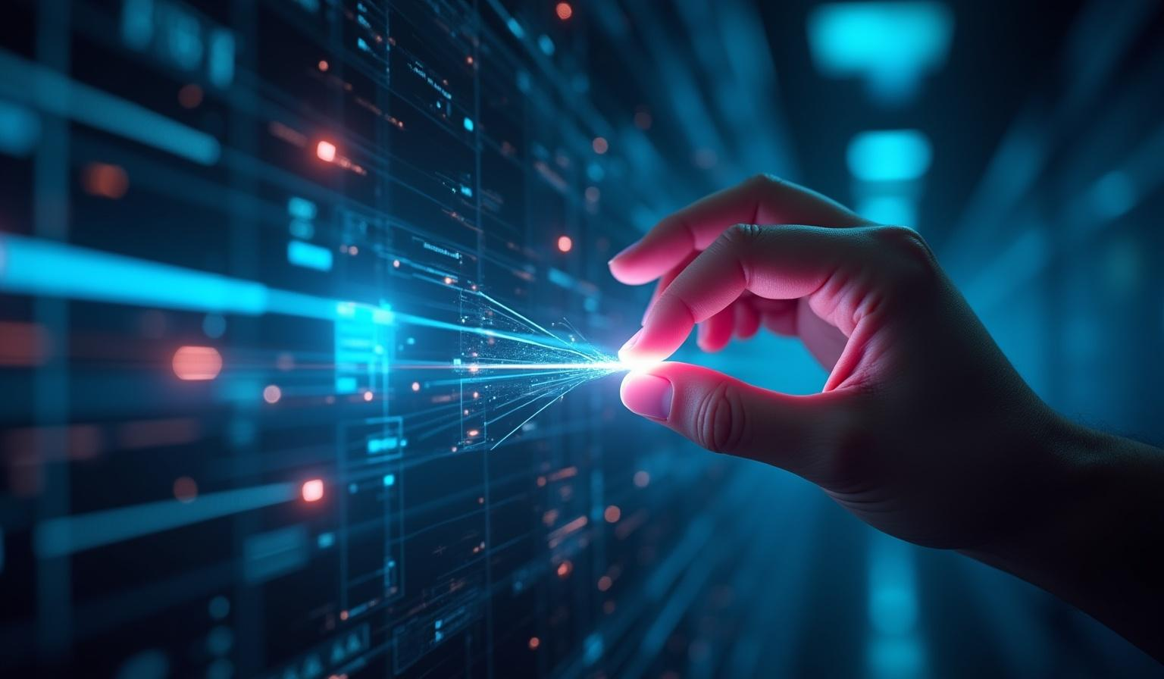
Virtual Paint
Draw in the air using finger tracking — AI ML internship project

Slide 2
Introduction
Virtual Paint — Draw in the Air using Finger Tracking
Student: Abhishek Kumar
Course: BCA
Internship : AI ML Internship
College: IGNOU
Duration of Internship : 45 Days
Guide : Shekhar Verma

Slide 3
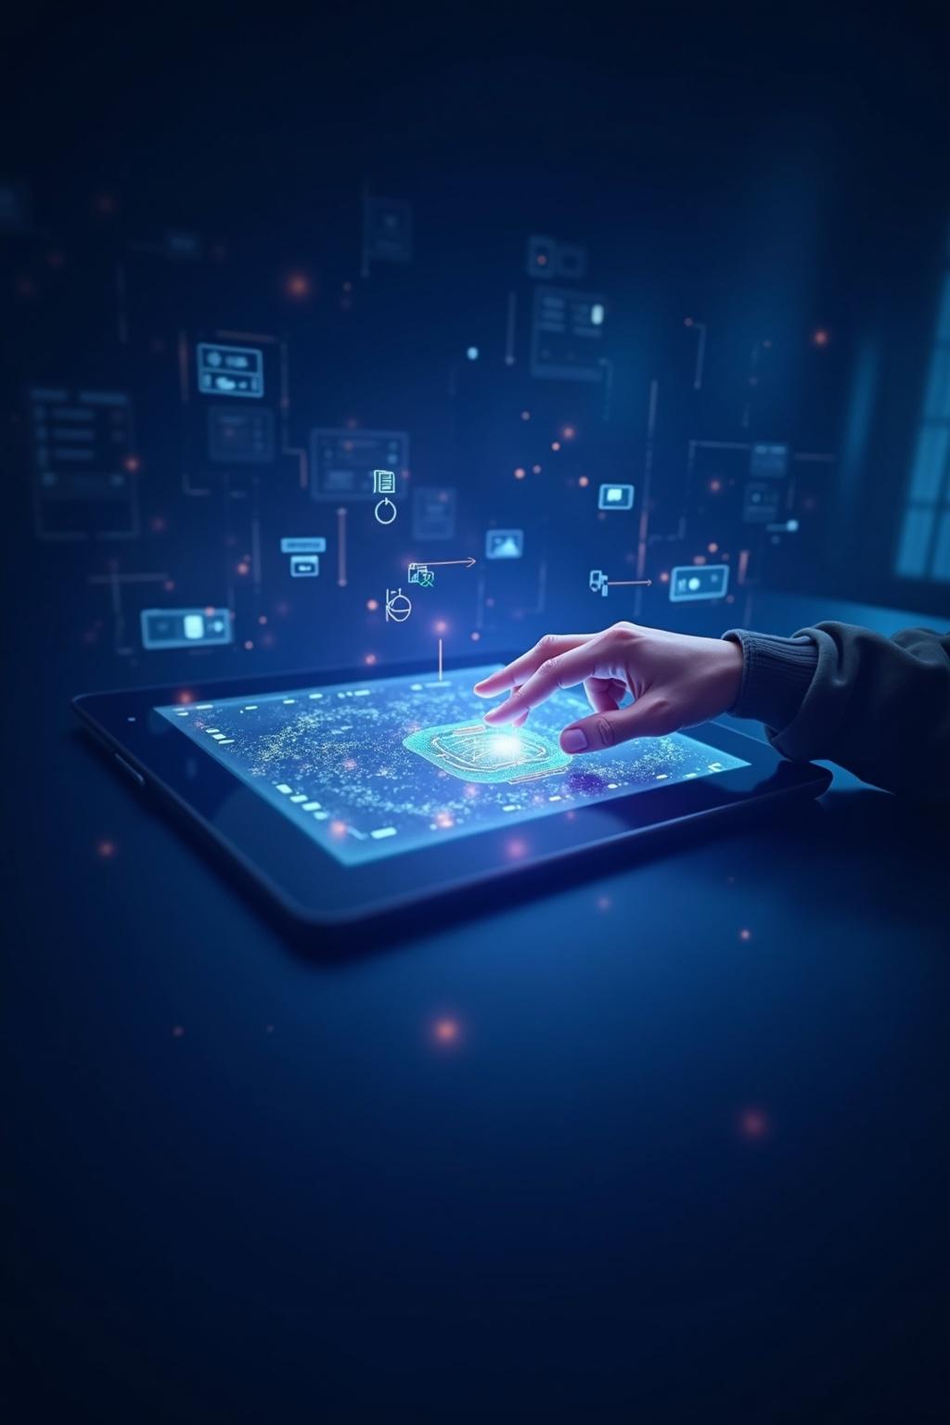
Introduction & Context
Introduction :
Computer Vision allows machines to understand visual input.
This project implements a touchless drawing system using hand gestures.
Real-time finger tracking is used to convert hand movement into digital strokes.
The system improves natural interaction without physical input devices.

Slide 4
Problem Statement
Traditional drawing requires mouse, stylus, or touch screen.
These methods limit mobility and touchless interaction.
Need for an intuitive gesture-based drawing system using only a webcam.
The project solves this by implementing real-time fingertip tracking.

Slide 5
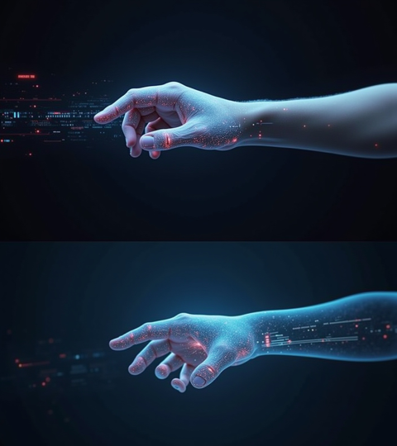
Objective :
Track index finger in real time using MediaPipe.
Create a virtual canvas for drawing.
Implement gesture-based tool selection.
Provide smooth drawing experience using stroke buffering.
Enable color selection, eraser, and clear screen functionality.

Slide 6
Technologies Used :
Python (Programming Language)
OpenCV (Image Processing & UI Rendering)
MediaPipe (Hand Landmark Detection)
NumPy (Canvas Creation & Frame Operations)
Webcam (Input Device)

Slide 7
System Workflow
Workflow :
Capture frame from webcamDetect
hand landmarks using MediaPipe
Track index fingertip position
Recognize gesture (drawing / selection mode)
Draw strokes on virtual canvas
Merge canvas with live video output

Slide 8
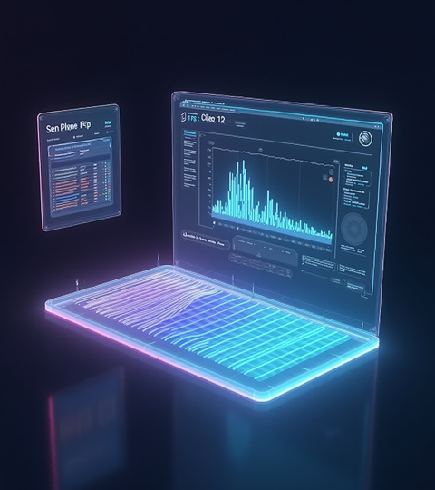
Features & Implementation
Gesture-based drawing control
Multiple color palette selection
Eraser tool
Clear screen functionality
Smooth stroke rendering using deque buffer
Real-time FPS performance display
Wide HD interactive interface

Slide 9
Challenges Faced :
MediaPipe installation issue (mp.solutions error due to Python version compatibility)
Gesture misclassification during fast hand movement
Jittery drawing strokes initially
UI interaction stability improvement

Slide 10
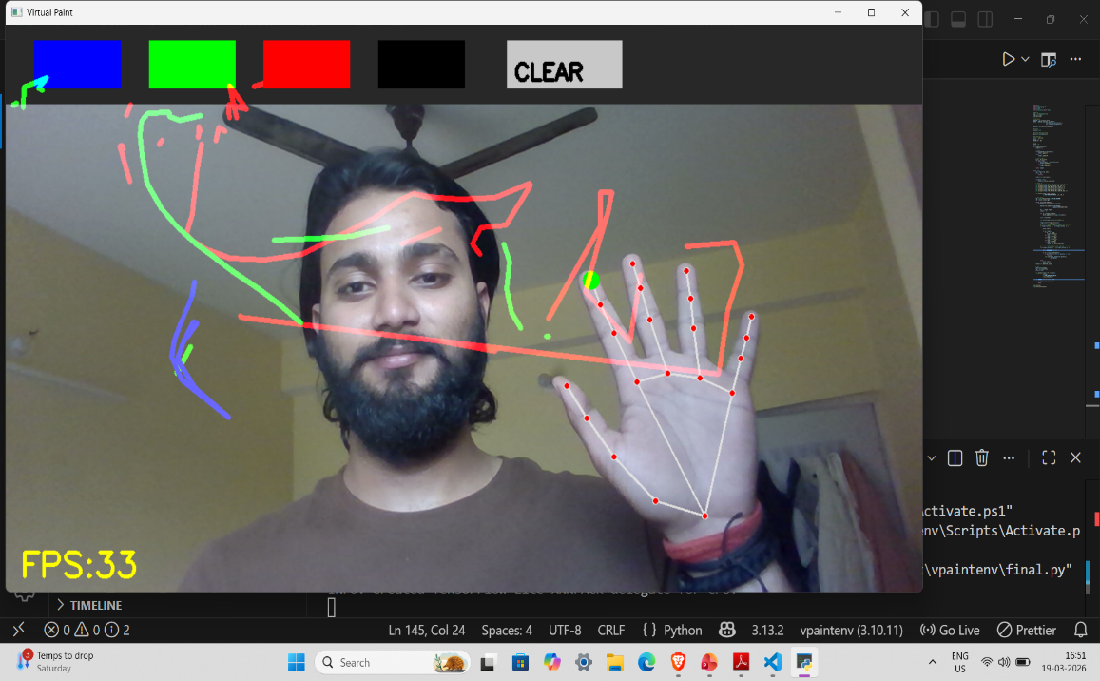
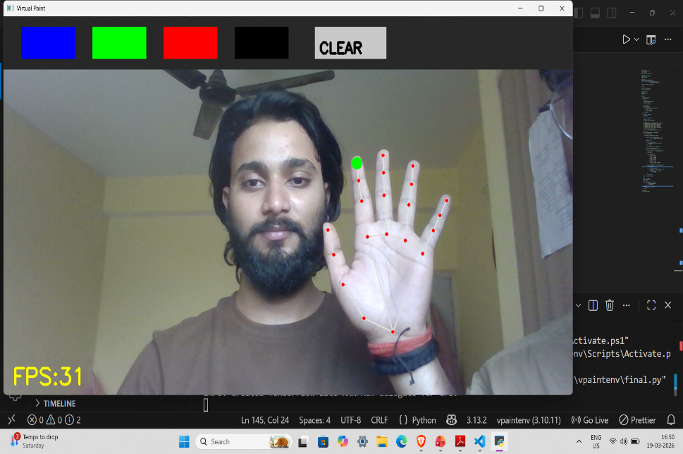
Output :
Real-time virtual drawing successfully achieved
Smooth interaction using gesture recognition
Responsive color selection and erasing
System performs efficiently with stable FPS

Slide 11
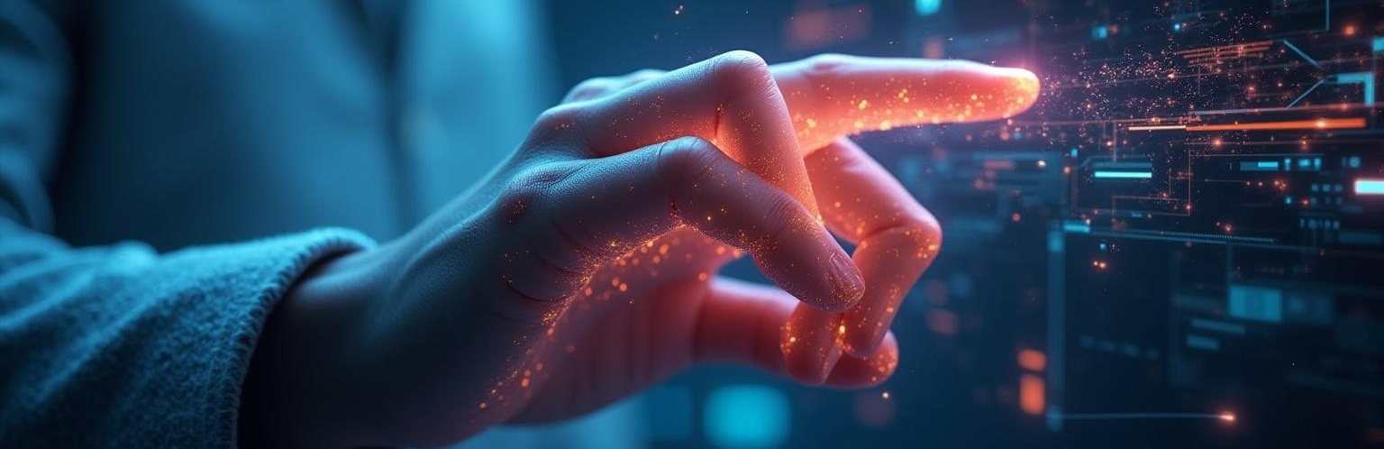
Conclusions & Future Scope :
Conclusion:
Successfully developed gesture-based virtual painting system
Demonstrated real-time computer vision interaction
Achieved smooth drawing using stroke buffering
Future Scope:
Brush size control using gestures
Save drawing feature
Multi-hand tracking
Improved lighting robustness

